Slide 1

Travel Expert
Software Project
PRESENTER: John, Megha, Brian and Mahmood
November 21, 2014

Slide 2




The MMBJ Team
John
Megha
Brian
Mahmood
Team Lead
Software developer
Software developer
Software developer

Slide 3
Goals
User friendly system and interface
Easy to store information for customers and agents
Application compatibility with hardware and software
Quality of majorability
Ability to collect feedback
Specialization among agents

Slide 4
Objectives
Reducing customer complaints by 80%
Improving time management
Efficient booking by reducing complexity

Slide 5
Assumptions - Contingencies
1
Users technical skills
1
User training / orientation of system
2
Hardware failure
2
Daily backups
3
OS / software failure
3
Antivirus software
4
Office power system failure
4
UPS: Uninterrupted Power Supply system
5
Conflicts / variations
5
Keep hard copies/ maintenance period

Slide 6
Assumption: Users Technical Skills
Contingency Plan: User Training / Orientation of System
Setting training goals
Assessment of end user needs
Software training
Training delivery methods
Group demonstration of system using projector
One to one training / feedback
Training documentation
Hard copies of training material for new employees

Slide 7
Assumption: Hardware Failure
Contingency Plan:
Running diagnostic tests periodically
Implementing mirroring
RAID 1 (identical copy of data on two disks)

Slide 8
Assumption: OS / Software failure
Contingency Plan: AV Software / backups
Using industry standard antivirus software
Daily Incremental backups
Stored in fireproof cabinet
Weekly full backups
Two copies of full backup
Placing both copies at different locations (one at off-site)

Slide 9
Assumption: Power Failure
Office Power System Failure
Loss of data
Reduced sales
Can damage hardware
Liabilities from services not provided
Contingency Plan: UPS
Industry standard Uninterrupted Power Supply System

Slide 10
Assumption: Conflicts / Variations
Contingency Plan:
Keep hard copies for evaluation
Weekly / monthly reviews in meeting
3 months maintenance period
Change in the code
Change in the layout / structure
Change in the reporting system

Slide 11
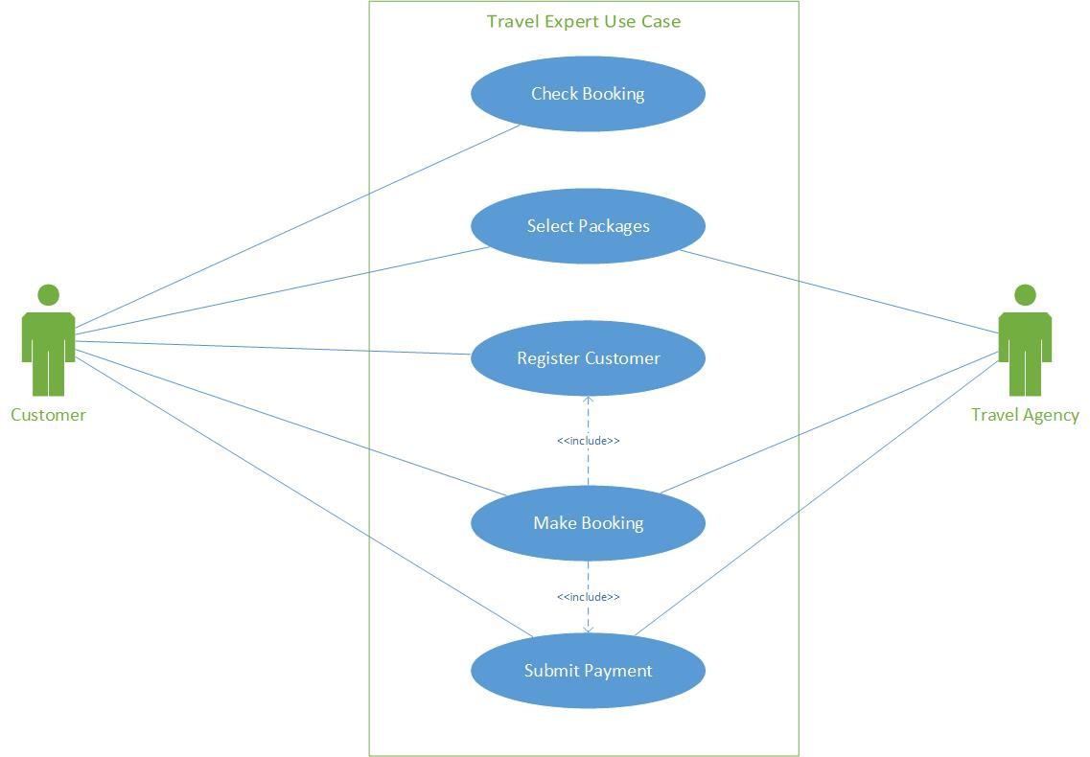
Use Case diagram

Slide 12
Scope definition
Database design
Application development
Web based menu
Web based reports
Placing order online

Slide 13
Additional Features
Future Implementation
Agent Login
Language translation
Comprehensive packages e.g. car rentals, hotels, bookings, airlines etc.

Slide 14
for being here

